Slide 1


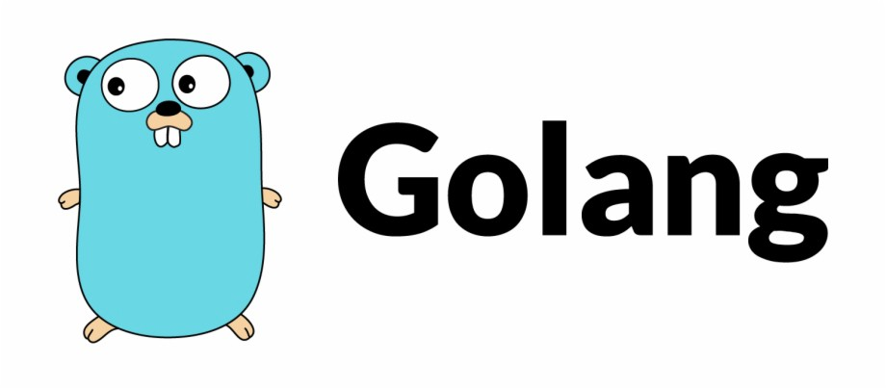
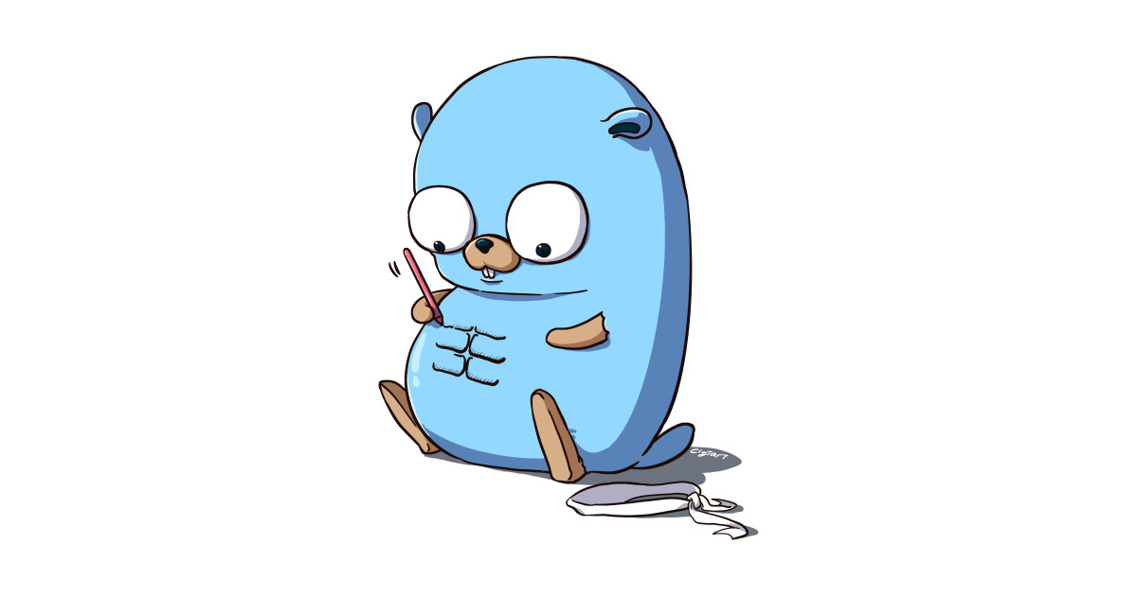
Tech Talk with
Mark Zelou Garces
06-25-2021
V1.0.0

Slide 2
What is Go?
Go is a statically typed, compiled programming language
Developed ~2007 at Google by Robert Griesemer, Rob Pike, Ken Thompson
Open Source
C-like syntax
Garbage Collection
Built-in Concurrency
No classes or type inheritance or overloading or generics

Slide 3
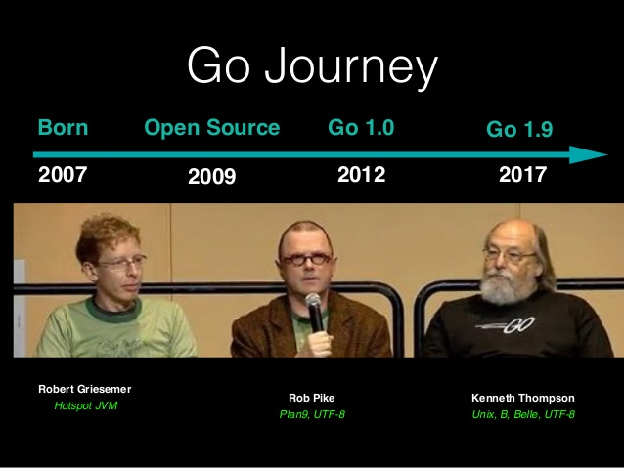
What is Go?

Slide 4
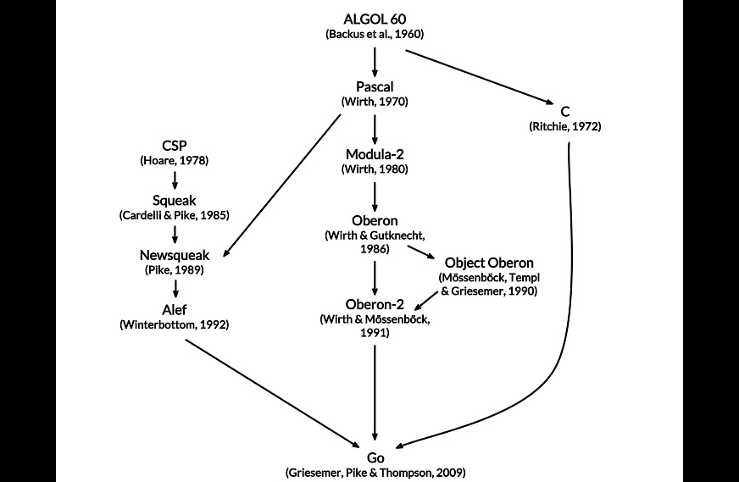
What is Go?

Slide 5
About Golang
Go is not a product of a classical programming language research
Focuses on software engineering and real world practices
Designed to for next generation applications (distributed and concurrent computing environments)

Slide 6
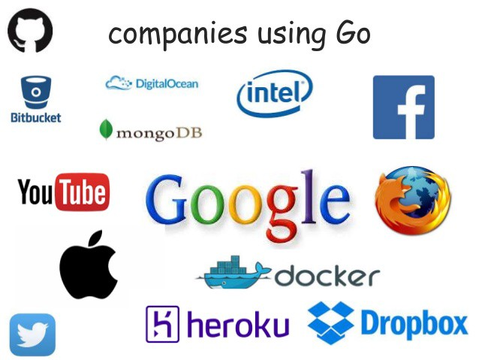
Who uses Go?
https://github.com/golang/go/wiki/GoUsers
Google
Docker
Dropbox
eBay
Facebook
Twitter
...and counting

Slide 7
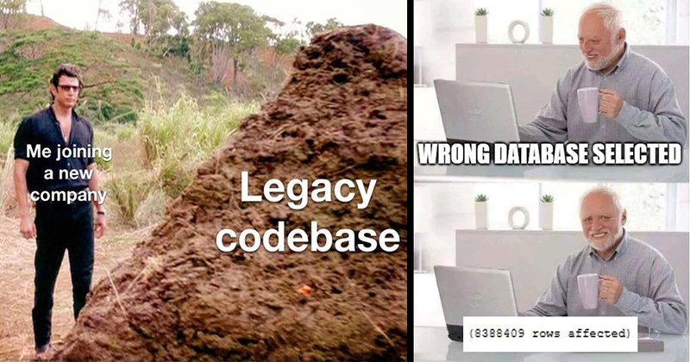
Problems in software development environments
Huge Codebase

Slide 8
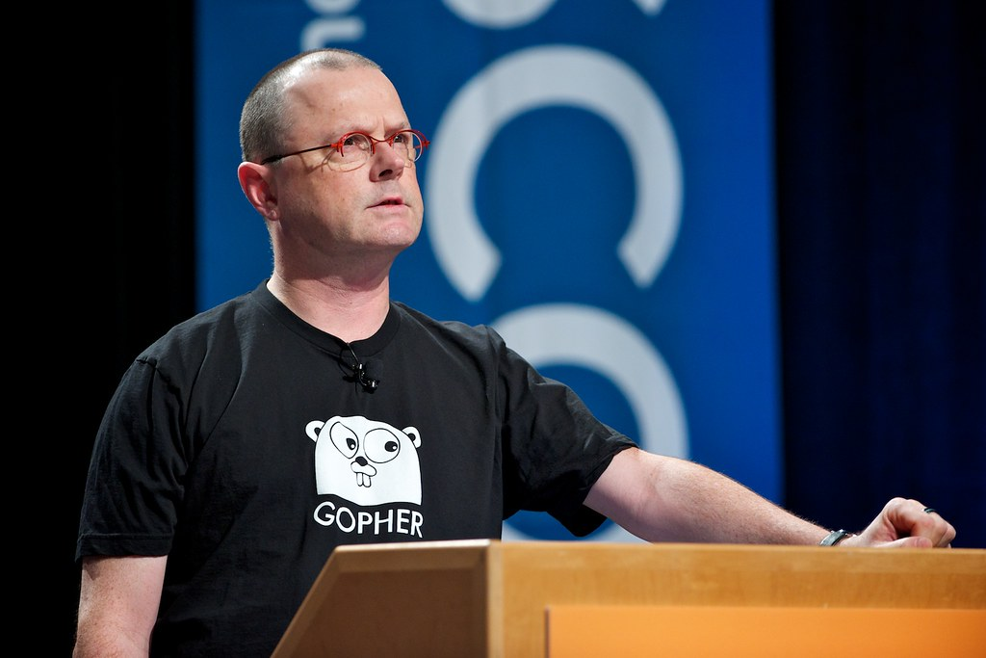
Problems in software development environments
Writing readable code
“Readable means reliable” (Rob Pike)

Slide 9

Problems in software development environments
Slow builds

Slide 10
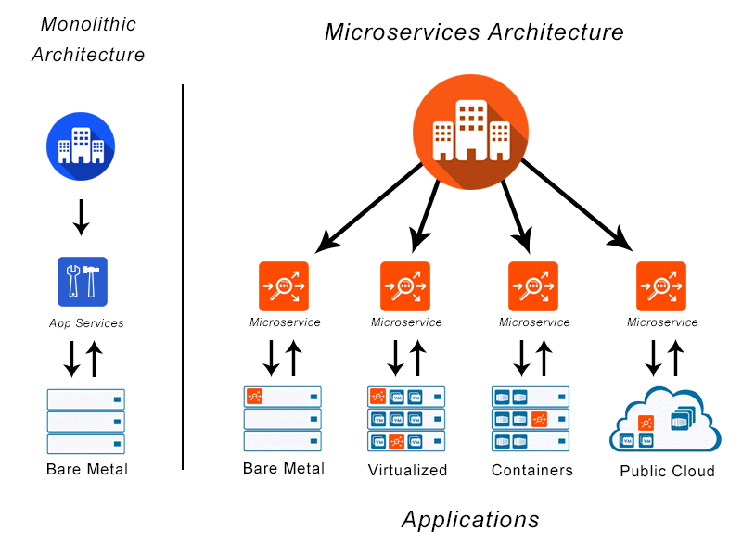
Problems in software development environments
Dependency Management
Distributed Environment

Slide 11
Why Go?
- Fast compilation
- Compiles into one executable file
- Compiles to native machine code, no need for environments like JVM, CLR
- Advantages using with application containers (Docker)
- Simple syntax (only 25 keywords)
- Garbage collection
- Makes easier to work at distributed and concurrent environments

Slide 12
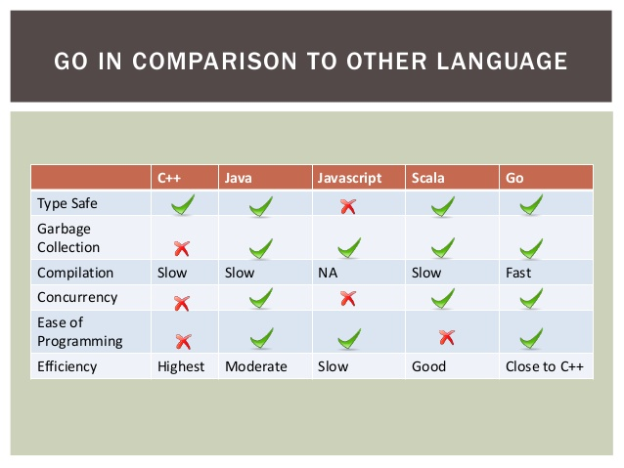
Go vs Other Languages

Slide 13
Syntax
Similar syntax to C, C++
Only 25 keywords (C99 has 37; C++11 has 84, Java has 50)
Types are written after declaration
var lines []string
func ReadFile(filePath string) ([]string, error)
Function
func Sqrt(x T) float64
Method
func (x T) Sqrt() float64

Slide 14
Types, constants, variables
Basic types
bool string int8 int16 int32 int64 uint8 … int uint
float32 float64 complex64 complex128
quotes: ‘hello’, “UTF-8 string”, `raw string`
Variables
var c1, c2 rune
var x, y, z = 0, 1.23, false // variable declaration
x := 0; y := 1.23; z := false // short variable declaration

Slide 15
Types, constants, variables
Operators
mostly like C, but ++ and -- are postfix only and not expressions
assignment is not an expression
no ?: operator

Slide 16
Arrays and Slices
An array is a fixed-length sequence of same-type items
months := []string {1:"Jan", 2:"Feb", /*...,*/ 12:"Dec"}
A slice is a subsequence of an array
summer := months[6:9]
Q2 := months[4:7]
Elements accessed as slice[index]
Indices from 0 to len(slice)-1 inclusive
summer[0:3] is elements months[6:9]
summer[0] = "June"

Slide 17
Arrays and Slices
Loop over a slice with for range
for i, v := range summer {
fmt.Println(i, v)
}
Slices are very efficient (represented as small structures)
Most library functions work on slices

Slide 18
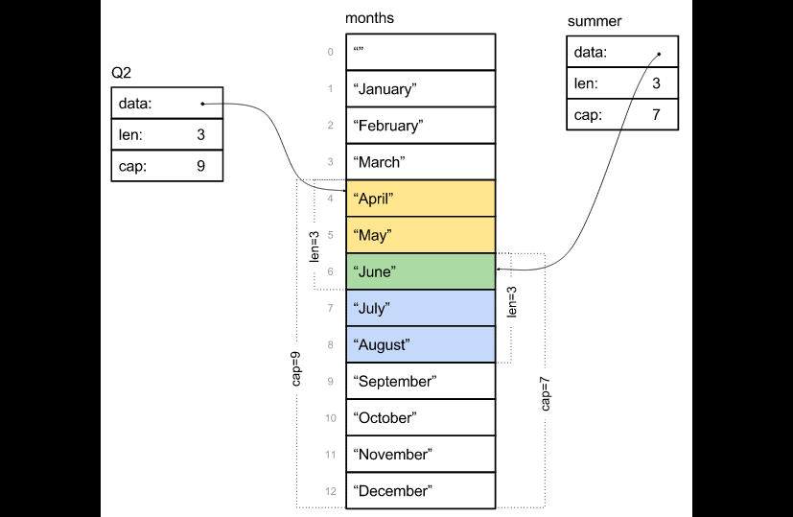
Arrays and Slices

Slide 19
Maps
Unordered collection of key-value pairs
Keys are any type that supports == and != operators
Values are any type

Slide 20
Methods and Pointers
Can define methods that work on any type, including your own:
type Vertex struct {
X, Y float64
}
func (v *Vertex) Scale(f float64) {
v.X = v.X * f
v.Y = v.Y * f
}
func (v Vertex) Abs() float64 {
return math.Sqrt(v.X*v.X + v.Y*v.Y)
}
func main() {
v := &Vertex{3, 4}
v.Scale(5)
fmt.Println(v, v.Abs())
}

Slide 21
Interfaces
An interface is satisfied by any type that implements all the methods of the interface
Completely abstract: can't instantiate one
Can have a variable with an interface type
Then assign to it a value of any type that has the methods the interface requires
A type implements an interface merely by defining the required methods
Sample:
type Writer interface {
Write(p []byte) (n int, err error)
}

Slide 22
Packages
It can return multiple values
import "encoding/json"
Remote packages
go get github.com/stretchr/testify
import "github.com/stretchr/testify/assert"
No Package versioning in language itself Godep (alternative)

Slide 23
Composition Not Inheritance
Go does not support inheritance in its type system, but it supports composition of types.
No type hierarchy
Allows method on any types not only on classes
Interfaces
type Reader interface {
Read(p []byte) (n int, err error)
}
No need to add implements keyword. Behaviours of an interface is fixed once and it is satisfied by types by having its methods
Wrappers (testing)
func LoggingReader(r io.Reader) io.Reader

Slide 24
Hello World
package main
import "fmt"
func main() {
fmt.Println("Hello World!")
}
$ go run hello.go # to compile and run
$ go build hello.go # to create a binary
$ go help # for more

Slide 25
Concurrency in Go
Concurrency and multi-threaded programming have a reputation for difficulty.
Partly due to complex design in language
Go uses Hoare's Communicating Sequential Processes (CSP) model.
Encourages safe concurrent programming

Slide 26
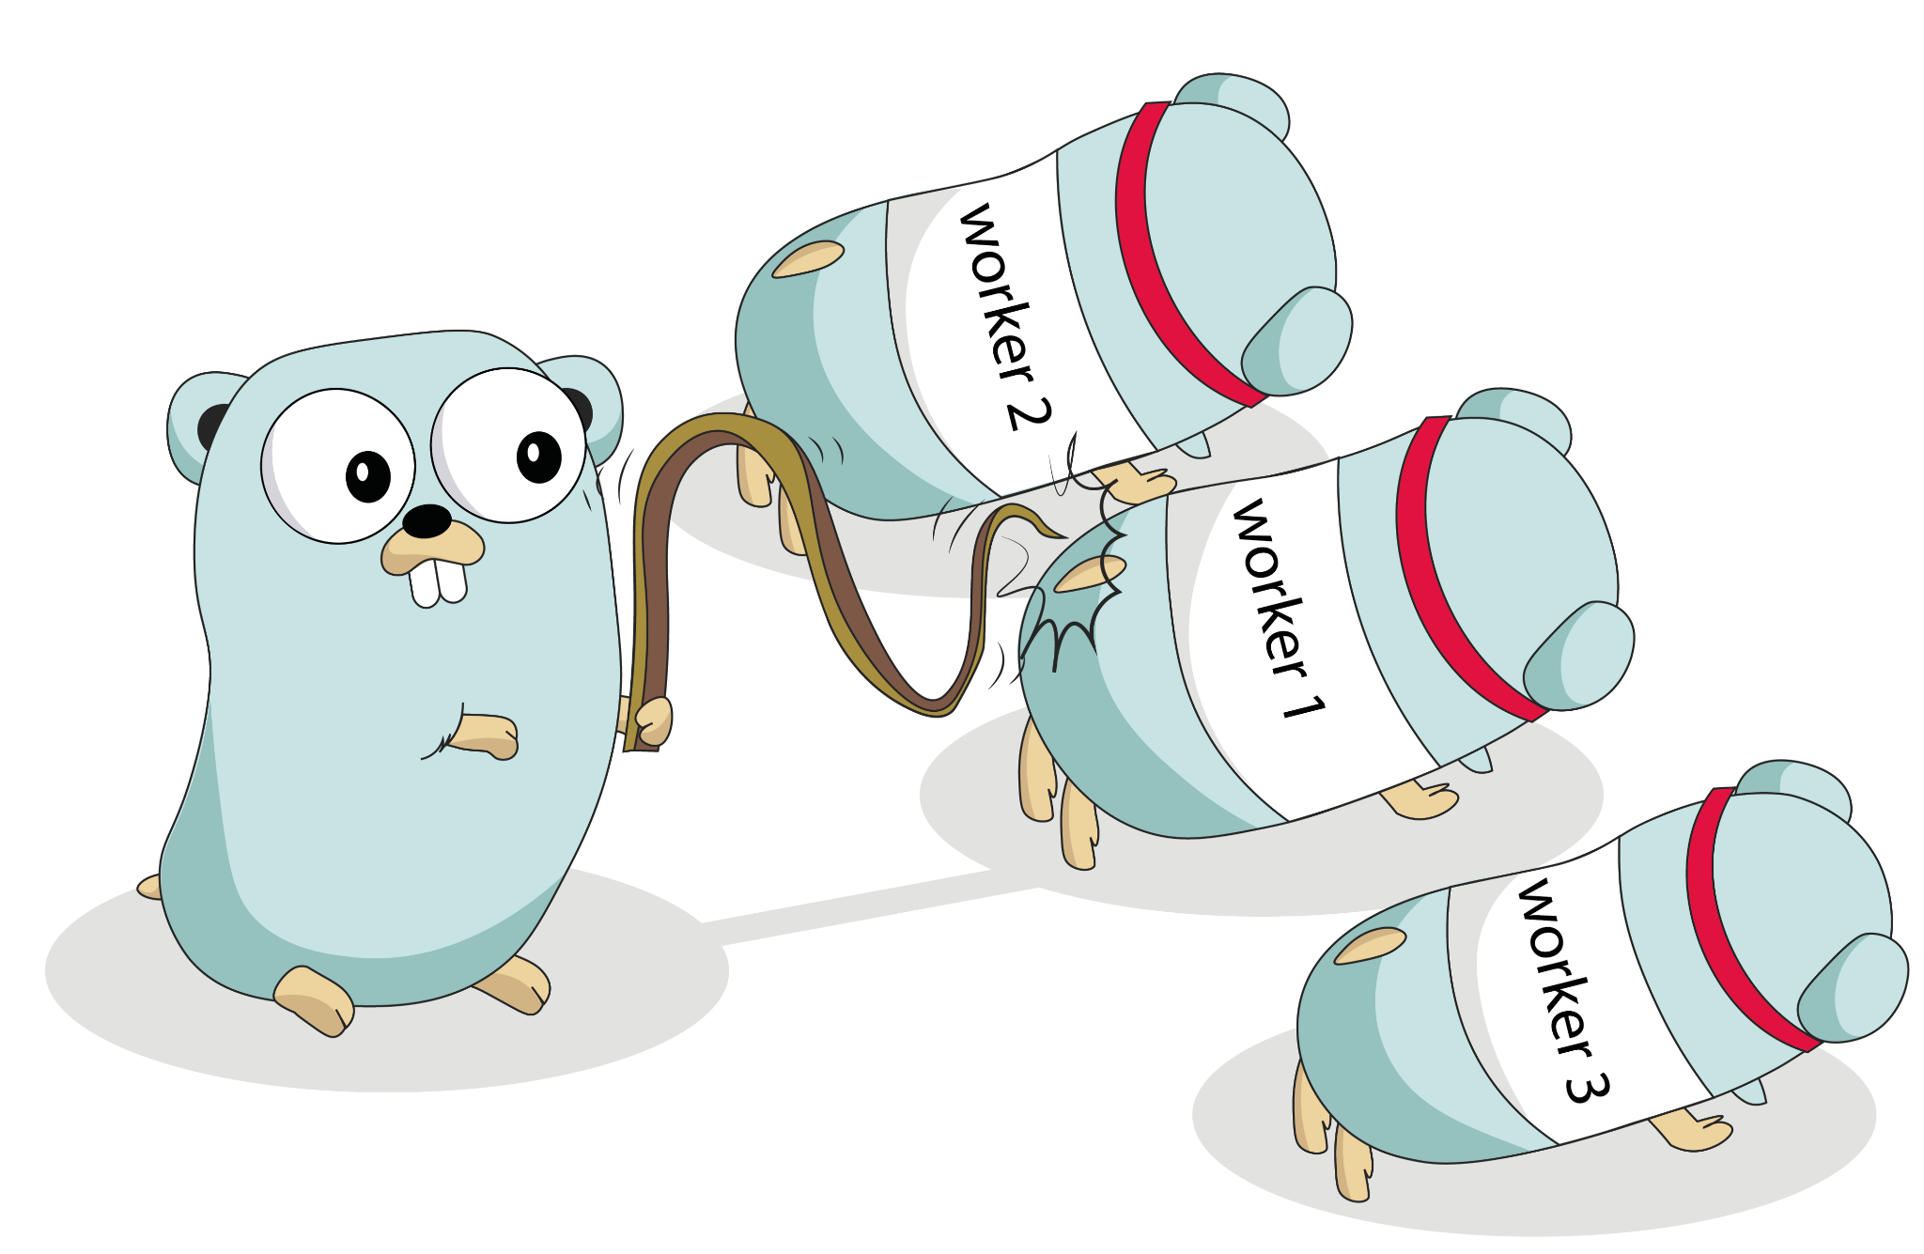
Concurrency in Go
The motto is, "Don't communicate by sharing memory, share memory by communicating."
Goroutines and channels
goroutines (execution)
channels (communication)
select (coordination)

Slide 27
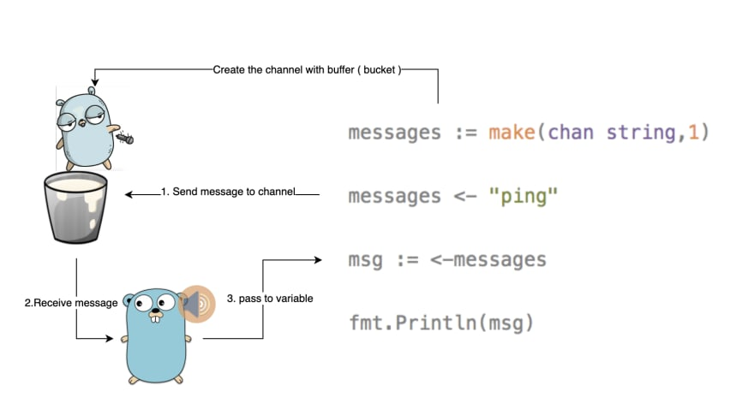
Concurrency in Go

Slide 28
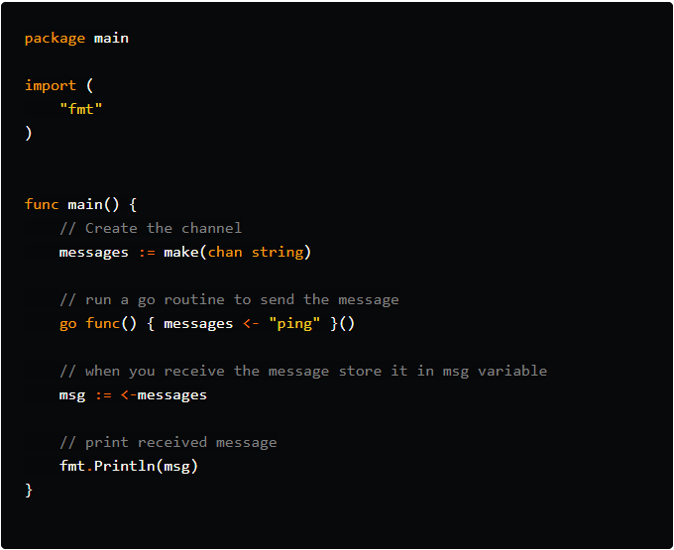
Concurrency in Go

Slide 29
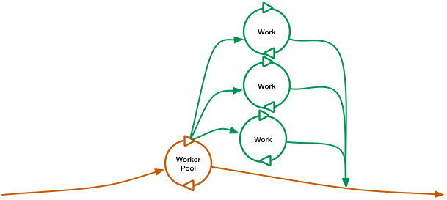
Concurrency in Go
Worker Pool

Slide 30
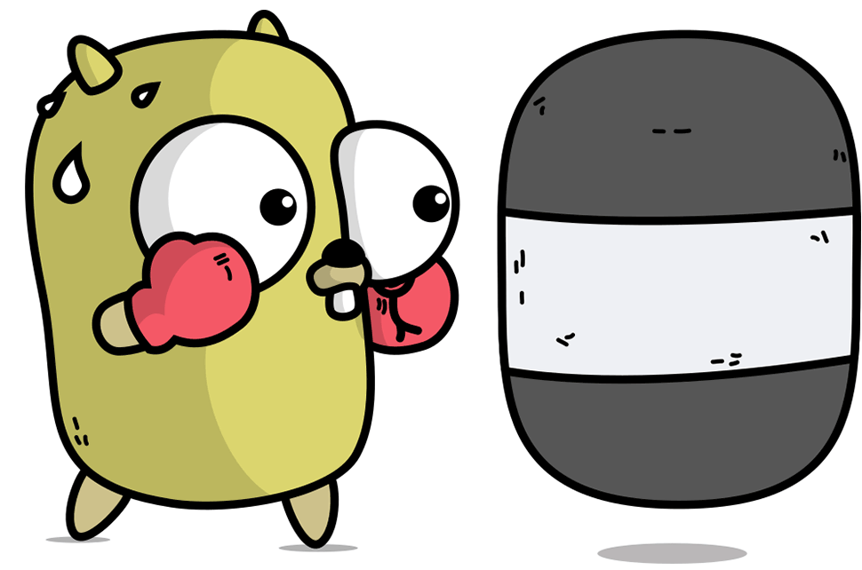
Questions?

Slide 31
Training Ground
[sites]
https://golang.org/doc/
https://tour.golang.org/moretypes/1
https://www.tutorialspoint.com/go/go_function_call_by_reference.htm
https://golangr.com/exercises/
[youtube]
https://www.youtube.com/watch?v=G3PvTWRIhZA&list=PLQVvvaa0QuDeF3hP0wQoSxpkqgRcgxMqX
https://www.youtube.com/watch?v=YS4e4q9oBaU
[IDE]
VScode - Free
https://code.visualstudio.com/
GoLand - Paid
https://www.jetbrains.com/go/promo/?gclid=CjwKCAjwjqT5BRAPEiwAJlBuBZQFzUzKco8D1qd-IgsmrhSIfpEQCOWf8DfkIGaMDw964OQH0FNbGRoCwYYQAvD_BwE

Slide 32

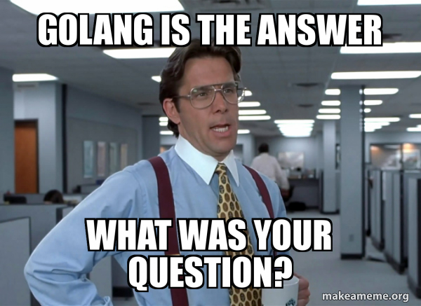
The End
https://github.com/fluffymarkz/golang_tech_talk
Rob Pike on why it is the way it is:
http://www.youtube.com/watch?v=rKnDgT73v8s
Russ Cox on interfaces, reflection, concurrency
http://research.swtch.com/gotour
Official website: https://golang.org/
Go tutorial, playground
https://play.golang.org/

